Slide 1

A Lifelong Asthma Case Study: Uncovering Triggers, Patterns, and Trends Through Data
Capstone Project by Abnerson Ocampo
March 26, 2025
Upright Education

Slide 2
Data Sponsor: Firsthand Asthma Case Study
Data: Personal Asthma Logs Dataset (Self-Collected, 2021-2024)
Description: This dataset consists of four years of manually recorded severe asthma episodes, including but not limited to:
Symptoms
Triggers
Vital Signs
Medications & Supplements
Environmental Conditions

Slide 3

Introduction

Slide 4
What is Asthma?
Asthma is a chronic respiratory condition that causes inflammation and narrowing of the airways, making breathing difficult. It is characterized by wheezing, shortness of breath, chest tightness, and coughing.
I have lived with asthma my entire life, experiencing firsthand the unpredictability of severe episodes. One day, I decided it was time to take control—to finally analyze this chronic illness once and for all and put my knowledge to good use.

Slide 5
Why This Study Matters?
Asthma is not a one-size-fits-all condition. Triggers, severity, and patterns vary from person to person—what causes a severe attack in one individual may have no effect on another. This is why a personalized, data-driven approach is essential.
This project goes beyond analysis—it’s a personal journey to uncover insights I’ve never explored before. From data collection to cleaning, exploration, and findings, this study transforms asthma logs into actionable insights. Not only does it enhance my asthma management, but it also shows how data can empower individuals to take control of their health.

Slide 6
Before diving into the data, I asked myself: What questions do I need to answer that will truly impact my life? Because as Data Analysts, our job isn’t just to create fancy charts—it’s to uncover critical insights that drive real change and create impact.

Slide 7
Key Questions We Aim to Answer:
How Long Do I Have Before My Breathing Becomes Critical?
What Factors Cause Faster Escalation to Severe Breathing Difficulty?
How Low Does My Oxygen Levels Drop Before Nebulization?
How Effective Is Nebulization in Recovering Oxygen Levels?
What Are My Major Key Asthma Triggers?
Is My Asthma Seasonal? Do Certain Months Have More Attacks?
When Do My Asthma Attacks Happen?

Slide 8
Exploratory Data Analysis
I will strive to provide actionable insights and impactful recommendations every step of the way, ensuring that the analysis helps shed light on practical steps for improving asthma care.

Slide 9
1. How Long Do I Have Before My Breathing Becomes Critical?
On average, there is a 15-min delay between the first symptoms of severe asthma and the moment nebulization becomes necessary.
This metric, referred to as Critical Response Window, represents the delay before reaching a state where nebulization is essential to prevent escalation to emergency intervention.
Understanding this response window is crucial, as it allows me to recognize early warning signs and take preventive measures.

Slide 10
Key Question # 1 - Recommendations
Be mindful of the average response window.
Recognize early symptoms: pay attention to coughing, wheezing, or chest tightness as early warning signs.
Keep medication readily available. Never ever forget your inhaler when going outside.
Work with a Doctor or specialist to create an asthma care plan based on the 15-min average response window we discovered.

Slide 11
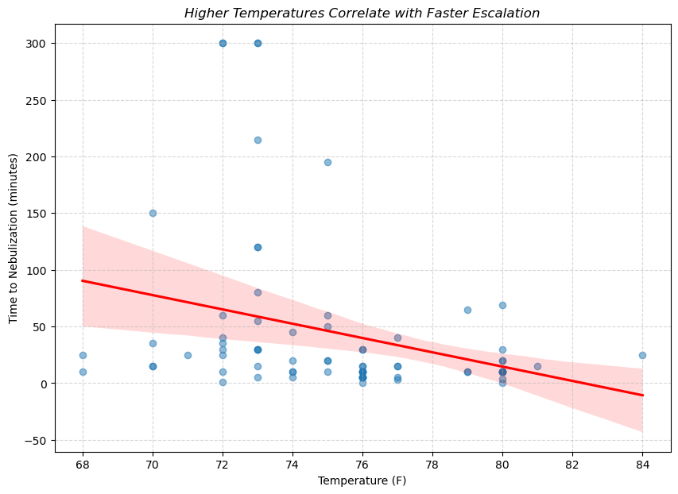
2. What Factors Cause Faster Escalation to Severe Breathing Difficulty?
Temperature
The downward trend suggests that, as temperature increases, the Critical Response Window tends to shorten, indicating that higher temperatures may contribute to faster asthma escalation.
Studies suggest that warmer temperatures can worsen breathing due to airway constriction, dehydration, and increased humidity.
Source: asthma-logs-dataset-2021-2024

Slide 12
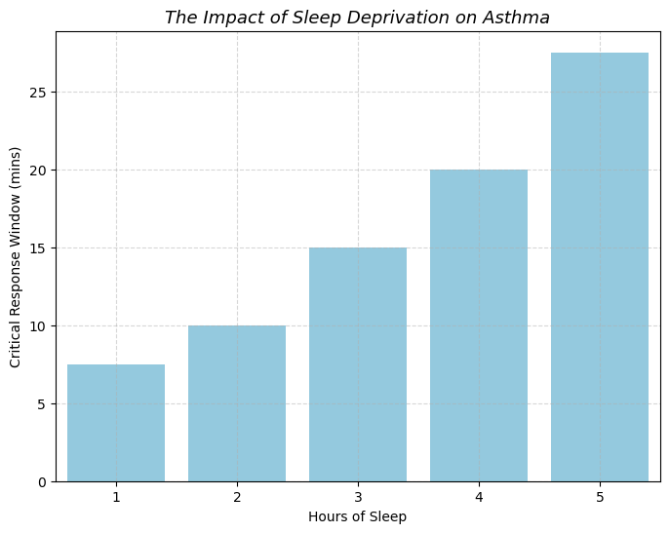
2. What Factors Cause Faster Escalation to Severe Breathing Difficulty?
Sleep
As sleep decreased, the Critical Response Window shrank drastically.
Less than 6 hours of sleep? A 27-minute window.
Less than 2 hours? 7 minutes left to act.
Sleep deprivation directly reduces the time available for intervention during severe asthma attacks.
Source: asthma-logs-dataset-2021-2024

Slide 13
Key Question # 2 - Recommendations
Regular hydration, combined with breathing exercises, can help reduce the burden on respiratory system during hot temperatures.
Avoid outdoor exposure during the hottest parts of the day, and make sure asthma medications are easily accessible.
Aim for at least 8 hours of sleep per night. Research indicates that this amount of sleep is beneficial to overall health.
Address sleep issues such as insomnia with a Doctor to improve sleep quality and asthma management.

Slide 14
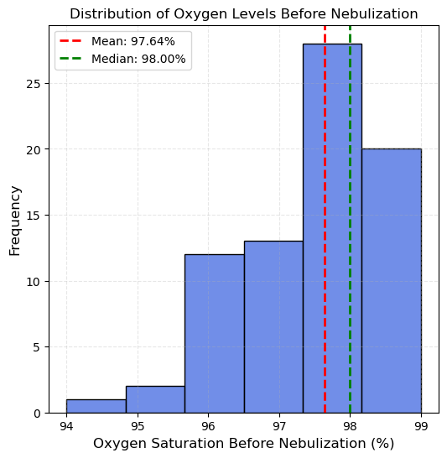
3. How Low Does My Oxygen Level Drop Before Nebulization?
Most episodes occurred within safe limits (97-98%), generally considered safe but enough to trigger severe breathing difficulty in my personal case.
A few instances showed oxygen levels dropping below 96% and as low as 94%, indicating rare yet potentially unsafe oxygen levels.
Note: Although my oxygen levels generally remain in the safe zone, rare but critical drops highlight the need for constant monitoring before levels dip too low.
Source: asthma-logs-dataset-2021-2024

Slide 15
Key Question # 3 - Recommendations
Monitor oxygen levels closely. Using a pulse oximeter can help track trends and detect early warning signs.
Stay prepared for rare drops in oxygen.
Consult a Doctor if oxygen levels drop frequently below safe levels, discussing alternative medications or treatment adjustment

Slide 16
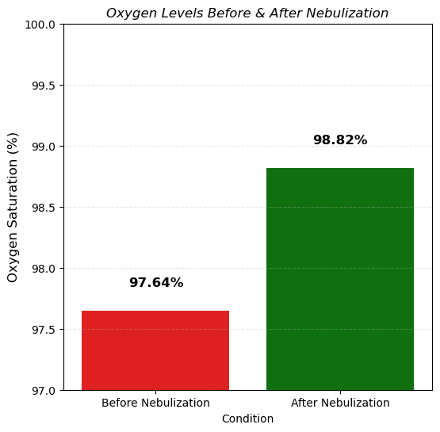
4. How Effective Is Nebulization in Recovering Oxygen Levels?
On average, after nebulization, my oxygen rises to 98.32%, meaning that treatment is reliably effective in restoring oxygen levels closer to normal.
Since my oxygen levels generally remain high, this suggests that severe asthma attacks may not always be linked to oxygen desaturation, reinforcing the importance of monitoring symptoms beyond just oxygen readings.
Source: asthma-logs-dataset-2021-2024

Slide 17
Key Question # 4 - Recommendations
Use oxygen as a guide, not the sole indicator. Since oxygen levels generally remain high, don’t solely rely on pulse oximeters to assess asthma severity. Monitor other symptoms like wheezing, tightness of chest, and fatigue.
Try to relax if oxygen levels are stable to control your breathing better, and to also lower heart rate. Don’t panic.
Continue nebulization for symptom relief. Nebulization still plays a critical role in improving airflow and easing breathing difficulties.

Slide 18
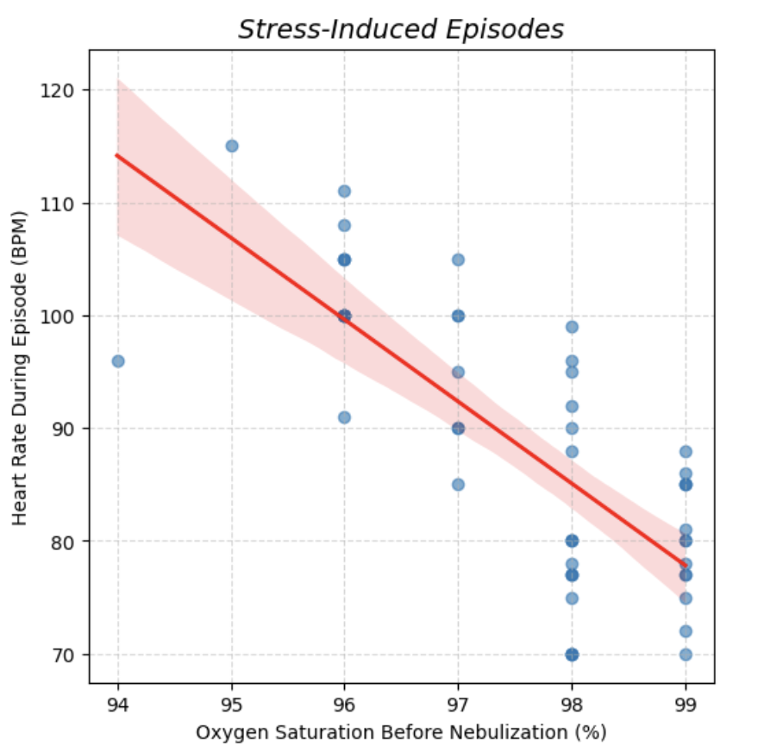
Stress
5. What Are My Major Key Asthma Triggers?
Critical Response Window: 20 mins
Average Heart Rate: 88.4 BPM
Average Oxygen Saturation: 97.55%
r = -0.7514, p = 0.0001
Source: asthma-logs-dataset-2021-2024

Slide 19
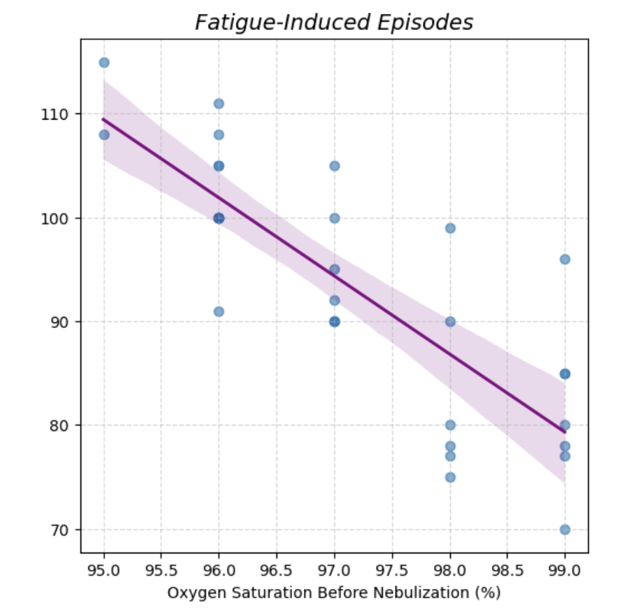

Fatigue
5. What Are My Major Key Asthma Triggers?
Critical Response Window: 27.5 mins
Average Heart Rate: 93 BPM
Average Oxygen Saturation: 97.19%
r = -0.8133, p = 0.0001
Source: asthma-logs-dataset-2021-2024

Slide 20
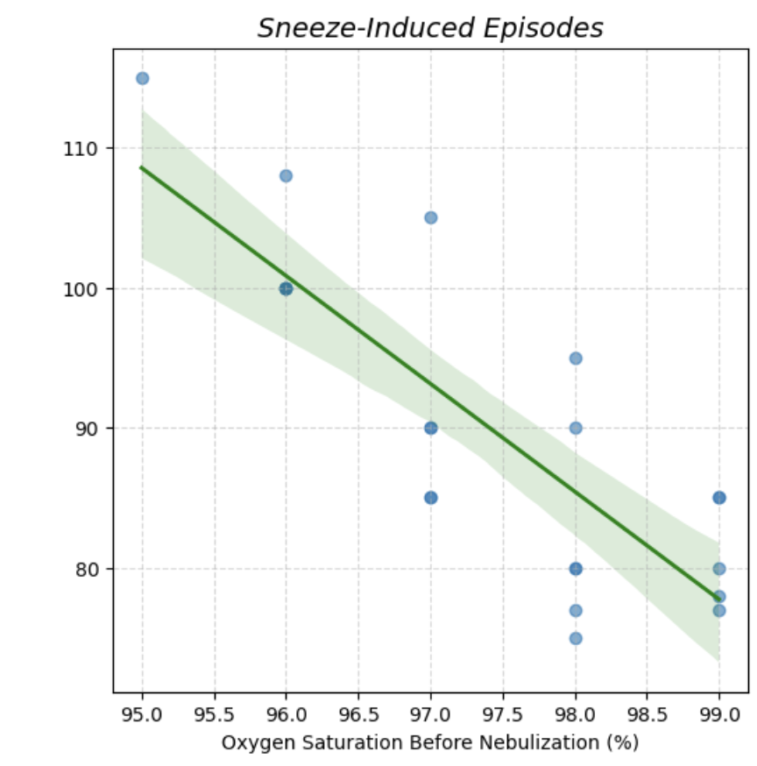
Sneeze
5. What Are My Major Key Asthma Triggers?
Critical Response Window: 35 mins
Average Heart Rate: 90 BPM
Average Oxygen Saturation: 97.41%
r = -0.8279, p = 0.0001
Source: asthma-logs-dataset-2021-2024

Slide 21
Key Question # 5 - Recommendations
Do stress-relieving activities like mindfulness and meditation, avoiding stress triggers etc.
Monitor energy levels and rest adequately to avoid fatigue-induced attacks. Optimize sleep quality.
Watch out and avoid known allergies.
Any combinations of these different triggers may potentially be threatening.
Always be ready to intervene earlier instead of waiting for symptoms to worsen.

Slide 22
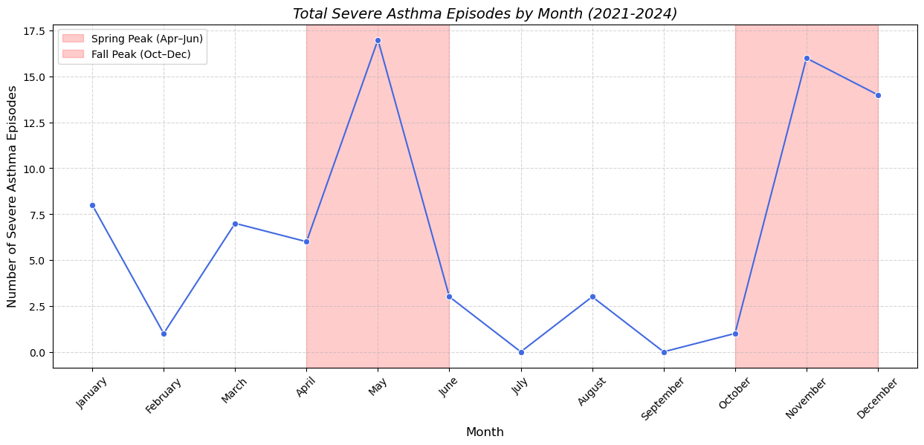
6. Is My Asthma Seasonal? Do Certain Months Have More Attacks?
Possible Reasons:
High pollen levels can trigger allergic asthma.
Changes in temperature.
Seasonal illness (cold & flu) could worsen asthma symptoms.
Cooler, drier air may irritate airways, making asthma attacks more frequent.
Past logs indicate these seasonal patterns are consistent across multiple years.
Seasonal peaks in Spring (April-Jun) and Fall (Oct-Dec)
Source: asthma-logs-dataset-2021-2024

Slide 23
Key Question # 6 - Recommendations
Use air purifiers or masks to reduce exposure to allergens and pollutants that may trigger asthma.
Track seasonal trends to prepare in advance for high-risk months.
Maintain hydration & humidity control indoors to prevent airway irritation from dry or cold air.
Limit outdoor exposure during peak pollen seasons.

Slide 24
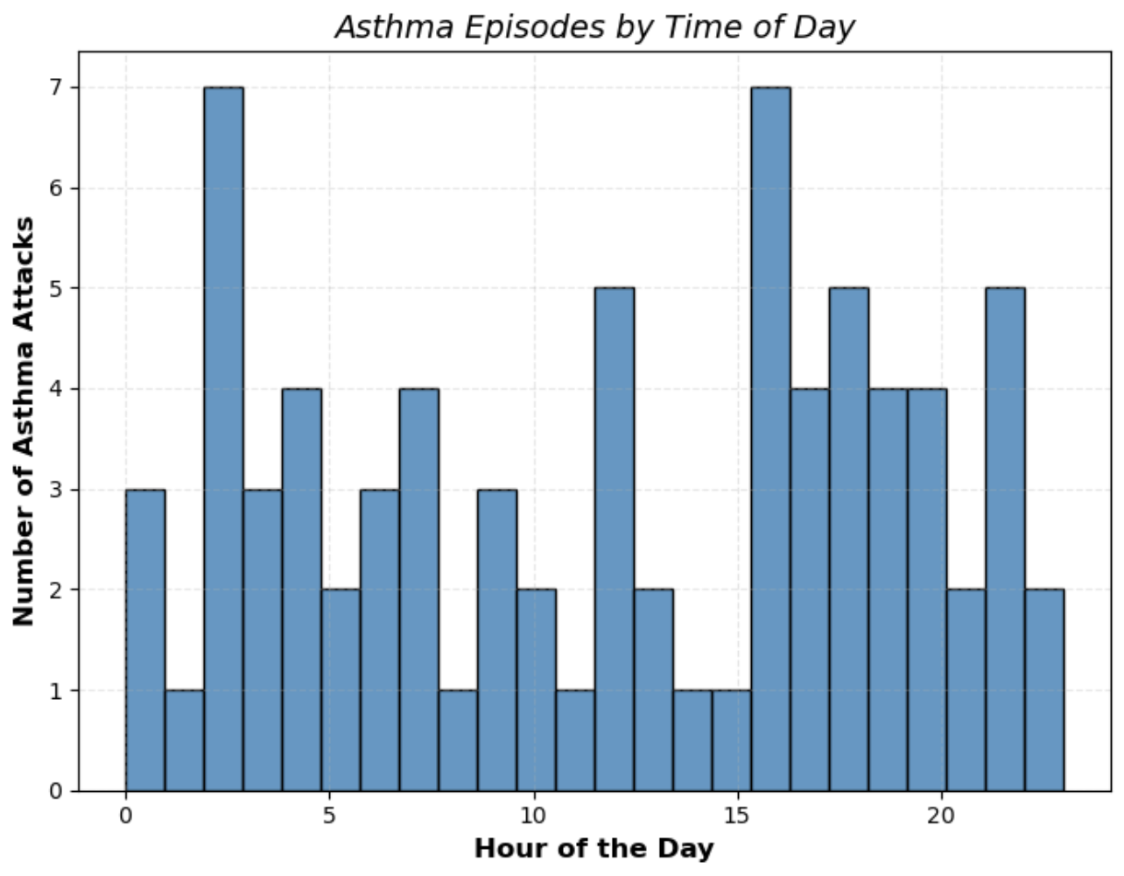
7. When Do My Attacks Happen?
There are noticeable peaks in severe asthma attacks around 3-4AM and 4-5PM.
The early morning attacks may be linked to circadian rhythms, and nighttime airway constriction, which can worsen asthma symptoms.
It could also be influenced by disruptions in my sleep schedule or an irregular body clock.
Source: asthma-logs-dataset-2021-2024

Slide 25
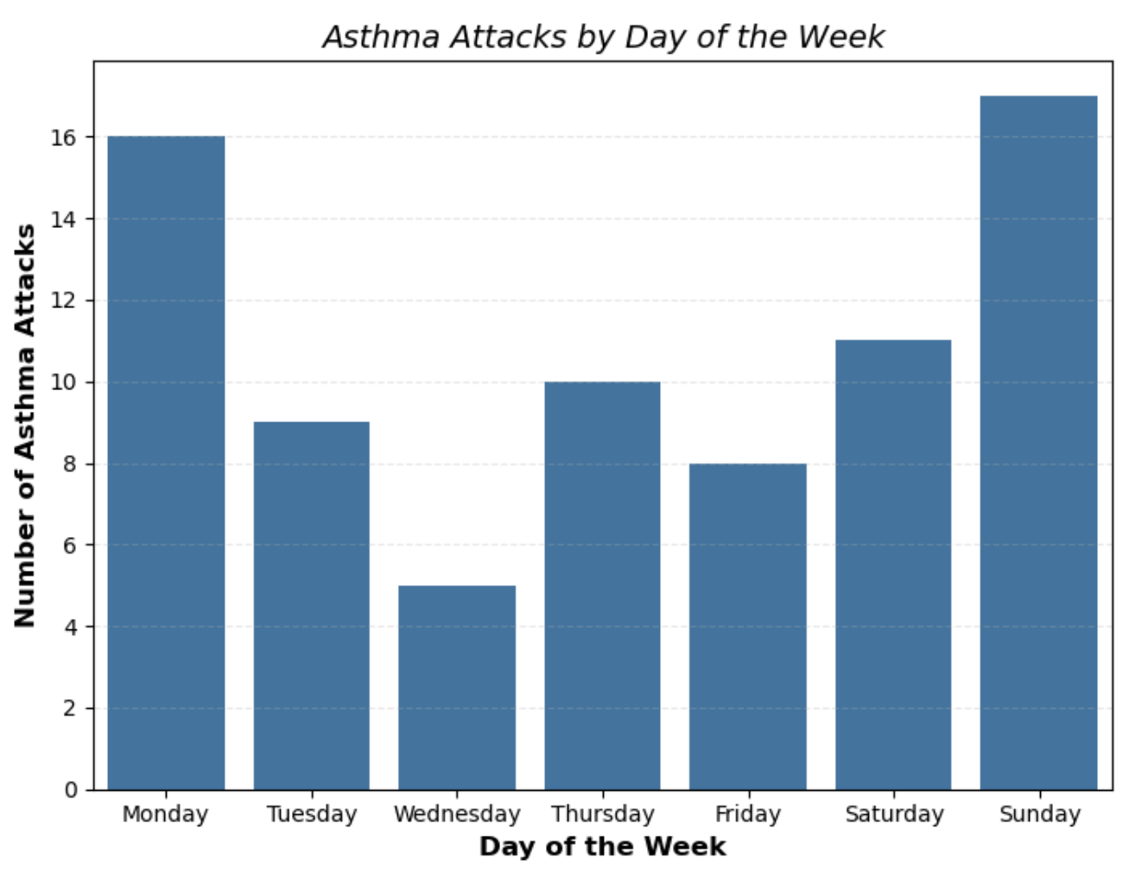
7. When Do My Attacks Happen?
The highest number of severe asthma attacks occur on Mondays and Sundays.
Monday spikes could be linked to work or school stress, and Monday blues.
Sunday spikes may be influenced by weekend activities, or disrupted sleep schedules before the start of a new week.
Wednesday and midweek days show lower attack rates, possibly due to more consistent routines, and less stress.
Source: asthma-logs-dataset-2021-2024

Slide 26
Key Question # 7 - Recommendations
Prioritize sufficient rest. Disrupted sleep can contribute to asthma exacerbations.
Aim for consistent bedtime and at least 7-9 hours of sleep per night to support better lung function and reduce nighttime attacks.
Maintain a consistent weekend routine – avoid drastic shifts in sleep, diet, or physical activity that could contribute to Sunday night disruptions.
If certain days have consistently higher attacks, consult with a Doctor about optimizing medication timing or preventive strategies.

Slide 27
Conclusion

Slide 28
As Data Analysts, our job isn’t just to create fancy charts—it’s to uncover critical insights that drive real change and create impact. This project is a reflection of that purpose, showing how data can empower individuals to take control of their health. With that said, though data can guide us, always consult a medical professional.

Slide 29
Thank You
I appreciate your time and attention throughout this presentation.
For the full analysis, visualizations, and code check the link here:
https://abnersonocampo.github.io/comprehensive-asthma-analysis/
Email: abnersonocampo@gmail.com | LinkedIn: https://linkedin.com/in/abnerson-ocampo/

